Slide 1
COVID-19 Vaccine Hesitancy Insights Report
28 July – 28 August 2020

Slide 2
Background: COVID-19 vaccine hesitancy report
This pilot study explores vaccine hesitancy conversation on social media in the UK and US. A growing number of polls in both countries have indicated that a significant number of people will refuse a COVID-19 vaccination when it becomes available.
We aim to conduct further in-depth vaccine hesitancy research, in the UK, US, and other regions to gain a deeper understanding of this issue. BrandsEye is looking to gather inputs from, and develop partnerships with, interested vaccine and healthcare stakeholders. By partnering with subject matter experts, we believe that we can develop a robust analysis to generate actionable insights that will benefit public health planning.
BrandsEye is uniquely positioned to conduct social media sentiment analysis. Our combination of AI and proprietary human crowds to structure social media conversation has proven valuable in predicting major binary public issues, including the 2016 US Election and Brexit referendum. Our Crowd is a large, distributed workforce who we curate and pay to verify and mark-up raw social media data. We use people to do this work as machines are not accurate enough in their ability to understand the nuances of human conversation, including sarcasm, idiom, slang, and emoticons - all of which are common in social media conversation. This human-verified approach allows us to deliver sentiment accuracy of 95% or better.

Slide 3
Sampling Methodology
The table below shows the total volume of Twitter mentions BrandsEye identified about a COVID-19 vaccine from 28 July – 28 August 2020. BrandsEye’s Crowd of human contributors evaluated the sentiment contained in 8 392 mentions. Mentions were assigned sentiment scores of positive, negative or neutral. 1505 mentions were categorised into a 9 hesitancy themes.
The resultant margin of error (MoE) for COVID-19 vaccine sentiment is below 2.5% for all regions analysed. This is calculated at a 95% confidence interval. Definitions of each classification theme is presented on the following slide.
 | Overall | United States | United KINGDOM
Total COVID-19 vaccine conversation | 243 883 | 219 671 | 24 212
Sentiment & classification verification | 8 392 | 4 887 | 3 505
Mentions tagged with classification | 1 505 | 839 | 666
Sentiment MOE | ±1.6% | ±2.1% | ±2.3%

Slide 4









Classification theme definitions
Conspiracy
Author believes that the COVID-19 vaccine is part of a conspiracy (not just money making). Eg: mark of the beast, tracking chips etc. No danger
Author accepts COVID-19 is real but does not think it is very dangerous or harmful.
Hoax
Author states that COVID-19 is a hoax, conspiracy or simply not real. Includes "plandemic" mentions.
Health & safety
Author references health safety issues, side effects of a COVID-19 vaccine or concerns about ingredients of the vaccine.
Mandatory
Author is against making the vaccine mandatory or believes it should be optional.
Pharmaceutical
Author doesn't trust the pharmaceutical industry. Eg: thinks they are tricking people, trying to make money etc.
Politics
Author believes the vaccine is political in nature or mistrusts the government about the vaccine.
Scientific process
Author thinks that the development of the vaccine is being rushed, has been poorly tested or is otherwise scientifically flawed.
Vaccine efficacy
Author is doubtful or skeptical about how effective a vaccine will be.

Slide 5
Key insights 1/2
COVID-19 vaccine hesitancy mentions were over three times more prevalent than COVID-19 vaccine advocacy mentions, with hesitancy mentions accounting for 28.2% of the conversation analysed, compared to 8.4% for advocacy.
Hesitancy mentions generated greater traction online. Hesitancy mentions generated an average of 4.8 engagements per post, tripling the engagement generated by advocacy mentions. This indicates that not only are hesitancy mentions more numerous, they also drive more interactions from other authors.
People are concerned about being forced to take the vaccine and are worried about side effects. Meanwhile, vaccine advocates shared news and developments about vaccine trials.
Vaccine distribution is a key issue for advocates. Advocacy mentions featured concerns about the fair and equal distribution of the vaccine upon availability.
Institutional distrust is a key issue in vaccine discourse. This emerged as a central theme that underlies COVID-19 vaccine conversation and was evident in mentions from both hesitancy and advocacy authors.

Slide 6


Key insights 2/2
UNITED STATES
The United States had a marginally higher percentage of hesitancy mentions than the United Kingdom.
Health & safety was the top driver of hesitancy conversation. Authors shared NIAID director Dr Fauci’s warnings about the premature release of a vaccine, as mentions highlighted concerns around unknown side-effects and adverse reactions.
Libertarian ideology was prevalent in hesitancy conversation related to mandatory vaccines, with US House Representative Thomas Massie driving engagement with a mention stating that vaccines should be voluntary and not mandatory.
US President, Donald J Trump’s relationship with Russia drove concern, as the president allegedly expressed the intention to distribute Russia’s COVID-19 vaccine.
Conspiracy theories and mentions about pharmaceutical companies were more prevalent in United States conversation compared to the United Kingdom.
UNITED KINGDOM
United Kingdom had a marginally higher percentage of advocacy mentions than the United States.
Government-mandated vaccines drove over a quarter of hesitancy conversation. Most of the mentions within this theme featured authors petitioning the UK Parliament to not place restrictions on those that refuse the vaccine.
Health & safety also drove hesitancy from UK authors. Previous medical failures, such as thalidomide, were cited by authors cautioning against rushing out a vaccine without sufficient testing. Authors also called on the UK government to hold pharmaceutical companies liable for harm caused by a COVID-19 vaccine.
This poses an imperative on pharmaceutical companies to provide adequate evidence and education around their testing policies for potential vaccines.
UK authors more frequently referred to the pandemic as a hoax generated by media hype, compared to US authors, who were more likely to attribute the pandemic to conspiracy theories, such as Bill Gates’ alleged plan to implant microchips into the public.

Slide 7
Hesitancy mentions were over three times more prevalent than advocacy mentions
What was the sentiment towards A COVID-19 vaccine?
Authors were most hesitant about a mandatory COVID-19 vaccine. Authors shared petitions to appeal restrictions that may be imposed on those who refuse the vaccine.
Health and safety was the second most prevalent theme cited, as authors worried about adverse reactions and side effects. Authors hypothesised that the scientific process followed to produce the vaccine would be flawed due to institutions rushing to find an answer to the pandemic.
Hesitancy mentions on average generated 4.8 engagements, 3.3 times higher than that seen in advocacy mentions.
Authors mentioning developments in vaccine trials accounted for nearly a fifth of all advocacy conversation. These mentions also featured calls to action aimed at finding human volunteers in order to accelerate the research.
Vaccine advocates expressed concern about the equitable distribution of the COVID-19 vaccine. This highlights a trend of institutional distrust that underlies vaccine-related conversation from both advocates and sceptics alike.
Advocacy mentions generated an average of 1.4 engagements per mention.
Total verified volume n = 8 392.

Slide 8
United States authors were more hesitant towards a COVID-19 vaccine
How SENTIMENT DIFFER PER REGION?
The United States saw a lower ratio of advocacy mentions and a higher ratio of hesitancy mentions compared to the combined aggregate.
Conversely, the United Kingdom saw a higher ratio of advocacy mentions and a lower ratio of hesitancy mentions.
United States
United Kingdom
Total verified volume n = 4 887.
Total verified volume n = 3 511.
Hesitancy
Neutral
Advocacy

Slide 9
President Trump’s alleged connection to Russia drove political conversation from United States authors
HOW DID THE TOP THEMES COMPARE ACROSS REGIONS?
Similar themes emerged in hesitancy conversation from both United States and United Kingdom authors. Health & safety, mandatory, scientific process, and pharmaceutical all featured in the top four most-cited themes for both regions.
Mandatory vaccines were a greater concern for UK authors, while health & safety was the largest driver of hesitancy conversation for US authors.
The regions deviated in the fifth most cited theme, with politics driving conversation in the US, and vaccine efficacy for UK authors.
Trump and Russia were the most common themes in politics mentions from the US. Authors cautioned against using a vaccine produced in Russia after it was alleged that Trump intends to distribute the vaccine to US citizens.
Vaccine efficacy conversation related to concerns about sufficiently testing the vaccine to ensure that is safe and effective.
United States
United Kingdom
1
Health & safety
Mandatory
2
Mandatory
Health & safety
3
Scientific process
Scientific process
4
Pharmaceutical
Pharmaceutical
5
Politics
Vaccine efficacy

Slide 10
United States authors widely engaged with warnings not to rush to produce the vaccine
WHAT DROVE VACCINE HESITANCY IN THE UNITED STATES?
Health & safety concerns featured in 15.1% of hesitancy conversation in the United States. An author generated 5 176 engagements with a mention that shared Dr Fauci’s warning against the premature distribution of the vaccine.
The infringement of personal liberty drove apprehension towards a government-mandated vaccine. US House Representative Thomas Massie generated engagement by stating, “Any COVID vaccine should be voluntary, not mandatory”.
Distrust towards “big pharma” was prevalent in pharmaceutical conversation. Authors shared articles alleging that pharmaceutical companies would be exempt from liability from harm caused by the vaccine. Authors also questioned why companies should be able to profit off taxpayer-funded vaccine research.
The above chart displays the top themes cited within United States hesitancy conversation.
The percentages reflect the ratio of theme volume to hesitancy volume.

Slide 11
United Kingdom authors petitioned against mandatory vaccinations
WHAT DROVE VACCINE HESITANCY IN THE UNITED KINGDOM?
Over a quarter of hesitancy conversation in the United Kingdom related to concerns about mandatory vaccinations. This was primarily driven by authors sharing a petition to prevent restrictions on those who abstain from the vaccine.
Health & safety was the second most prevalent theme cited. UK authors were also cautious about the risks associated with an under-tested vaccine and called on pharmaceutical companies to be liable for potential side effects.
Concerns about rushing to produce a vaccine were also evident in scientific process conversation. Authors cited thalidomide, a medication that when used while pregnant, causes high rates of infant mortality, which impacted up to 10 000 people in the early 1960s. Additionally, authors noted the failure to produce a successful HIV vaccine, despite years of research and testing.
The above chart displays the top themes cited within United Kingdom hesitancy conversation.
The percentages reflect the ratio of theme volume to hesitancy volume.

Slide 12
United Kingdom authors were more likely to think that the pandemic was a hoax
HOW DID THE TOP THEMES Deviate ACROSS REGIONS?
The adjacent chart overlays the drivers of vaccine hesitancy conversation for both regions. Further outward from the center indicates a greater prevalence of conversation within a theme.
Conspiracy, politics and pharmaceutical played a more significant role in US conversation. In conspiracy, authors alleged that vaccinations were the mark of the beast and shared disinformation about Bill Gates. While politics conversation centred around allegations that Trump would distribute Russia’s vaccine.
Mandatory and hoax were more prevalent in UK conversation. For the latter, authors asserted that coverage around the pandemic was aimed at scaring people into taking the vaccine.
Each grid line represents 5%, with the center point being 0%.

Slide 13
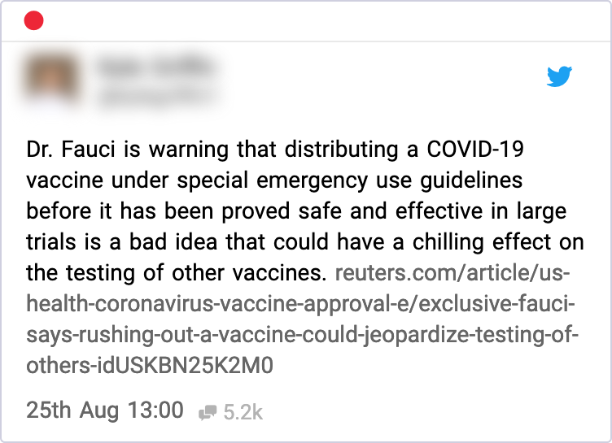
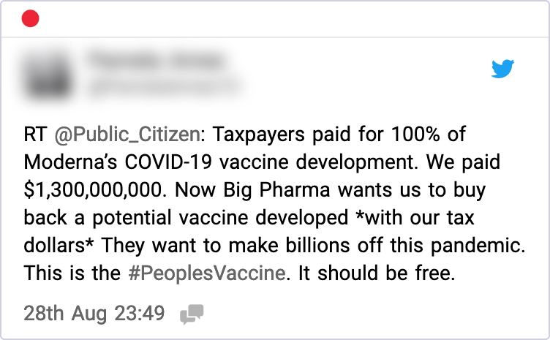
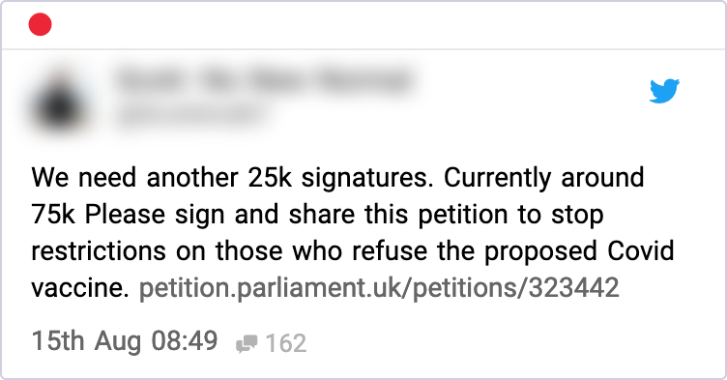
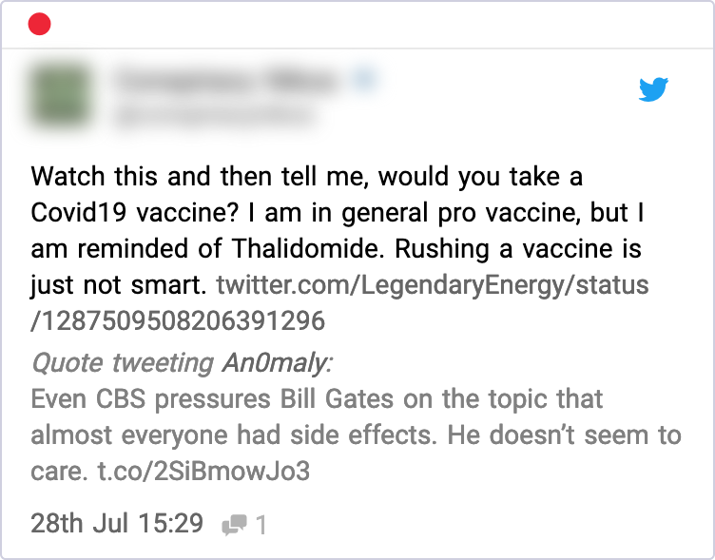
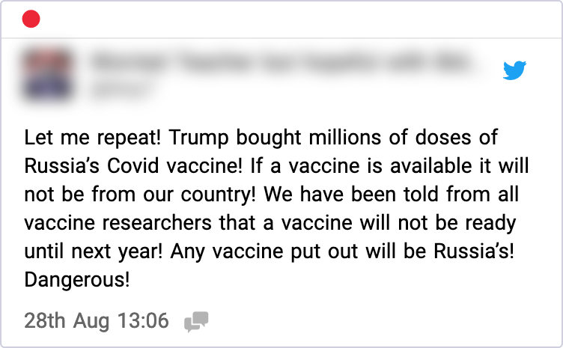
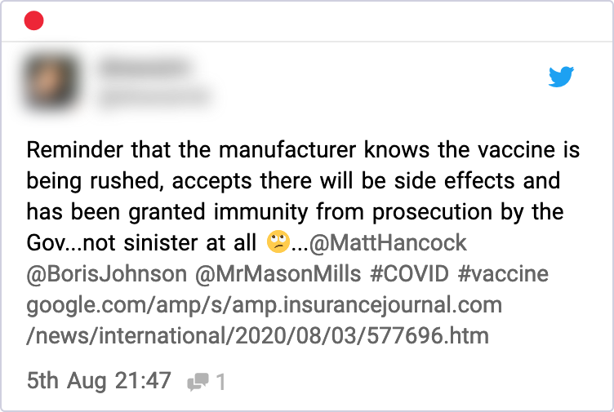
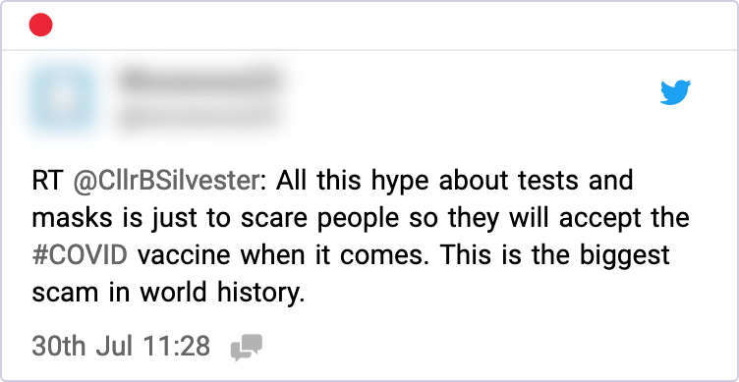
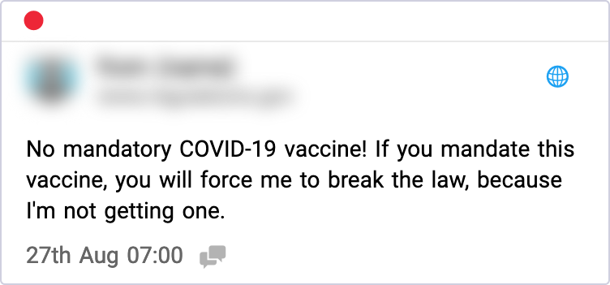
How did mentions compare across regions?
EXAMPLE MENTIONS PER REGION
United States
United Kingdom
Mentions anonymised to protect author privacy.

Slide 14
Glossary of terms
Volume and mentions
Volume is the number of mentions. BrandsEye counts each tweet, Facebook post or comment, blog post, or article as an individual mention.
OTS
Opportunities-to-see (OTS) reflects the number of individuals who would have had the opportunity to see a mention online; it represents the potential exposure of the content. OTS is based on the number of mentions and followers of the contributor(s).
Engagement
The engagement score consists of the total number of reshares and replies on a post.
Category
This refers to the type of author a mention comes from—consumer, press, enterprise (brand property, like Twitter handles, Facebook pages, or websites), or directory (classifieds).
Source
The source of a mention is the domain it comes from. For example, a tweet’s source is twitter.com, and an article’s source might be iol.co.za.
Net sentiment
Negative sentiment is subtracted from positive sentiment. This results in a net value. This value is useful as the sentiment at a specific point in time can be understood as a whole value.

